Slide 1
COMP 122/L Lecture 12
Mahdi Ebrahimi Slides adapted from Dr. Kyle Dewey

Slide 2
Outline
Memory instructions
Load (ldr)
Store (str)
Arrays

Slide 3
Memory Operations

Slide 4
Refresher
You’ve already seen one form of ldr for handling strings

Slide 5
Refresher
You’ve already seen one form of ldr for handling strings
.data my_string:
.asciz “hello”
.text
ldr r0, =my_string

Slide 6
Refresher
You’ve already seen one form of ldr for handling strings
.data my_string:
.asciz “hello”
.text
ldr r0, =my_string
Puts starting address of “hello” in r0
-This was used for setting up swi instructions
-While this uses memory, it did so indirectly (the swi instruction actually read the memory, not us)

Slide 7
Putting Integers in Memory
.word directive will put a 32-bit integer in memory, much like .asciz will put a string in memory

Slide 8
Putting Integers in Memory
.word directive will put a 32-bit integer in memory, much like .asciz will put a string in memory
.data my_string:
.asciz “hello” first_int:
.word 42 second_int:
.word 38

Slide 9
Step 1: use ldr to put its address into a register...
Reading Integers From Memory

Slide 10
Reading Integers From Memory
Step 1: use ldr to put its address into a register...
.data first_int:
.word 42 second_int:
.word 38
.text
ldr r0, =first_int

Slide 11
Reading Integers From Memory
Step 2: use ldr with [] to read the value at the address
.data first_int:
.word 42 second_int:
.word 38
.text
ldr r0, =first_int

Slide 12
Reading Integers From Memory
Step 2: use ldr with [] to read the value at the address
.data first_int:
.word 42 second_int:
.word 38
.text
ldr r0, =first_int ldr r1, [r0]

Slide 13


Reading Integers From Memory
Step 2: use ldr with [] to read the value at the address
.data first_int:
.word 42 second_int:
.word 38
.text
ldr r0, =first_int ldr r1, [r0]
r1: 42

Slide 14
Writing Integers to Memory
Step 1: use ldr to put its address into a register...

Slide 15
Writing Integers to Memory
Step 1: use ldr to put its address into a register...
.data first_int:
.word 42 second_int:
.word 38
.text
ldr r0, =first_int

Slide 16
Writing Integers to Memory
Step 2: use str to write a value at that address
.data first_int:
.word 42 second_int:
.word 38
.text
ldr r0, =first_int

Slide 17
Writing Integers to Memory
Step 2: use str to write a value at that address
.data first_int:
.word 42 57
second_int:
.word 38
.text
ldr r0, =first_int mov r1, #57
str r1, [r0]

Slide 18
Example:
memory_variables.s

Slide 19
Arrays

Slide 20
Specifying Arrays
Only distinction from variables:
multiple values are specified with the .word directive

Slide 21
Specifying Arrays
Only distinction from variables:
multiple values are specified with the .word directive
.data first_int:
.word 42

Slide 22
Specifying Arrays
Only distinction from variables:
multiple values are specified with the .word directive
.data first_int:
.word 42 array:
.word 32, 65, 76, 87

Slide 23
Accessing Arrays
Basic approach: increment memory address

Slide 24
Accessing Arrays
Basic approach: increment memory address
.data arr:
.word .text ldr r0, | 32, =arr | 65, 76
ldr r1, | [r0]
add r0, | r0, | #4
ldr r2, | [r0]
add r0, | r0, | #4
ldr r3, | [r0]
-Offsets increment by 4 because one word is 4 bytes

Slide 25





Accessing Arrays
Basic approach: increment memory address
.data arr:
.word 32, 65, 76
.text
ldr r0, =arr ldr r1, [r0]
r1: 32
add | r0, | r0, | #4
ldr | r2, | [r0]
add | r0, | r0, | #4
ldr | r3, | [r0]
r2: 65
r3: 76

Slide 26


Accessing Arrays
Basic approach: increment memory address
.data arr:
.word 32, 65, 76
32 | 65 | 76
arr | arr + 4 | arr + 8
.text
ldr r0, =arr ldr r1, [r0]
r1: 32
add | r0, | r0, | #4
ldr | r2, | [r0]
add | r0, | r0, | #4
ldr | r3, | [r0]
r2: 65
r3: 76
-Top right corner shows memory layout in terms of arr

Slide 27
Example:
register_indirect.s

Slide 28
More on Memory Access
ldr r3, [r0]
The above instruction uses the register indirect addressing mode
Addressing mode: how the processor accesses something
Register indirect: Memory access is done through an address in a register
Many more available: see register_*.s
-See also https://www.cs.uregina.ca/Links/class-info/301/ARM-addressing/lecture.html

Slide 29
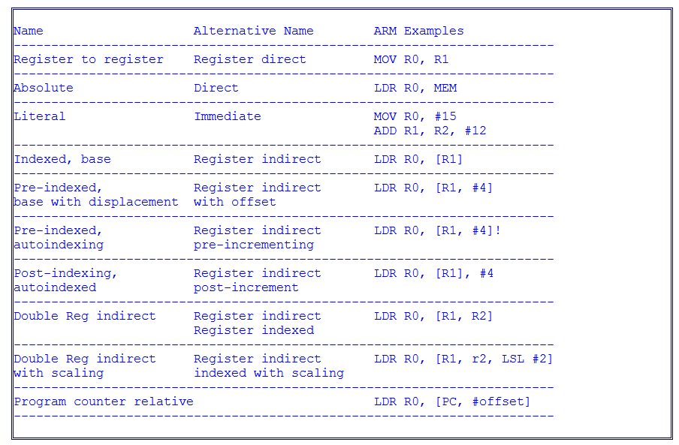
ARM addressing Modes
https://www.cs.uregina.ca/Links/class-info/301/ARM-addressing/lecture.html

Slide 30
ARM addressing Modes
Addressing Mode Assembly Mnemonic Effective address FinalValue in R1
---------------------------------------------------------------------------------------------------------------------------------
Indexed, base LDR R0, [R1] R1 R1
Register indirect
---------------------------------------------------------------------------------------------------------------------------------
Pre-indexed, LDR R0, [R1, #d] R1 + d R1
base with displacement
----------------------------------------------------------------------------------------------------------------------------------
Pre-indexed, LDR R0, [R1, #d]! R1 + d R1 + d
autoindexing
----------------------------------------------------------------------------------------------------------------------------------
Post-indexed, LDR R0, [R1], #d R1 R1 + d
autoindexed
----------------------------------------------------------------------------------------------------------------------------------
Double Reg indirect LDR R0, [R1, R2] R1 + R2 R1
----------------------------------------------------------------------------------------------------------------------------------
Double Reg indirect LDR R0, [R1, R2, LSL #2] R1 + (R2 * 4) R1 (R2 also unchanged)
with scaling
----------------------------------------------------------------------------------------------------------------------------------
https://www.cs.uregina.ca/Links/class-info/301/ARM-addressing/lecture.html

Slide 31
Array Access Example:
print_array_fixed_length.s

Slide 32
Writing to Array Example:
write_array_increasing.s

Slide 33
Another Array Access Example:
print_array_variable_length.s

